Slide 1
Intro to R
(FallR) – September 13, 2016
John Little and Joel Herndon
askdata@duke.edu
Notes:
Conventions- courier font means code

Slide 2
Background
Notes:
1. How many people have used a statistics package before? Which packages?
2. How many people have coded using a programming language before? Which languages?
3. How many of you have to use R for class? your own research? just interested?

Slide 3


R and R Studio
I’m the open source statistical programming language.
I’m a development environment for using the R programming language.
Notes:
After this slide, we do a bit of housekeeping.
get everyone in the same directory
access to files

Slide 4
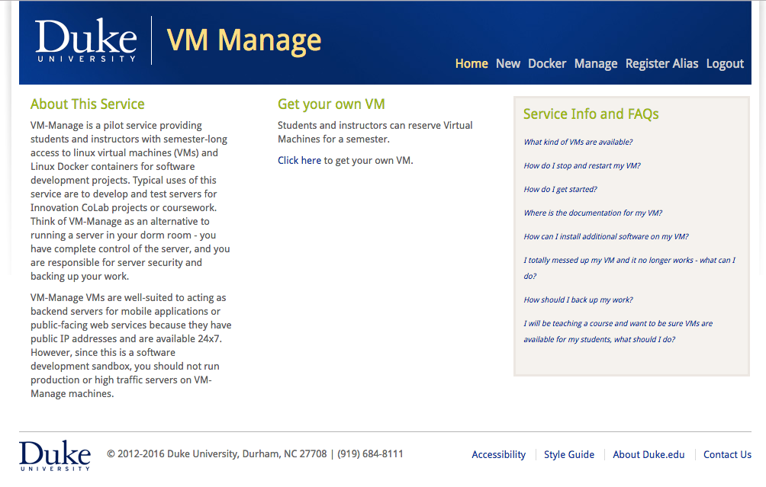
vm-manage.oit.duke.edu

Slide 5
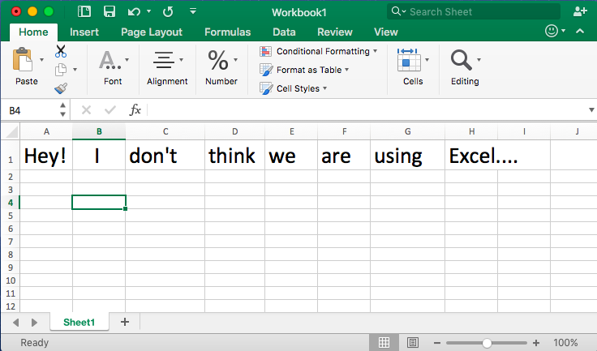
Notes:
First comment about R- it’s very different from systems that rely on point and click interfaces and detailed menus.
This is both a feature and potentially a real pain/challenge.
Actually- excel remains a pretty good way to enter data into R (but be careful there).

Slide 6
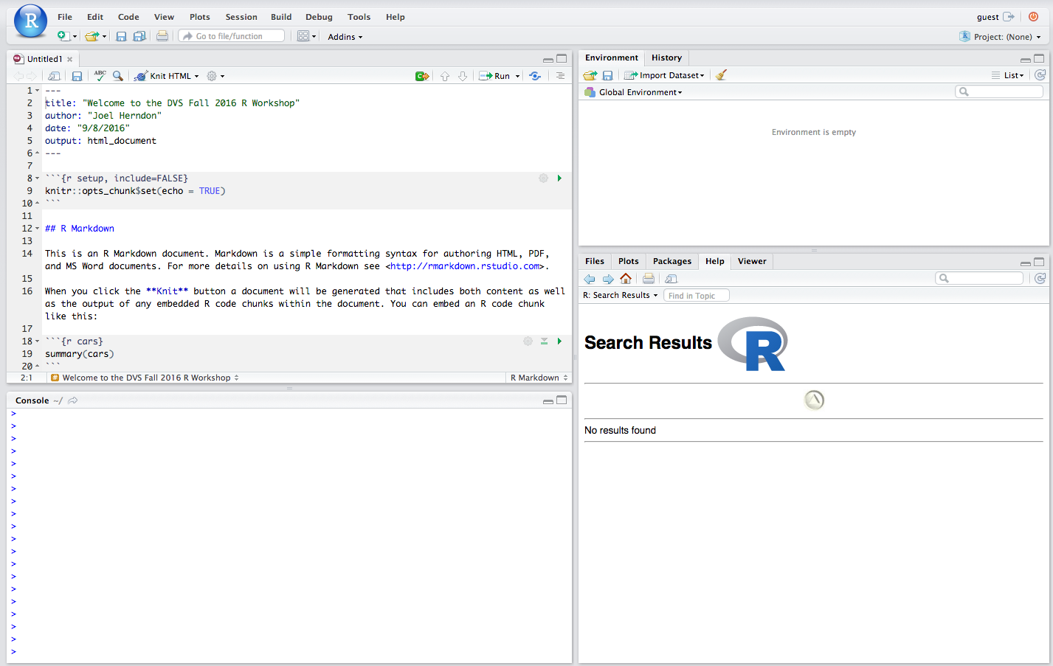

Slide 7
uploading Data to R in Docker
Notes:
1. How many people have used a statistics package before? Which packages?
2. How many people have coded using a programming language before? Which languages?
3. How many of you have to use R for class? your own research? just interested?

Slide 8
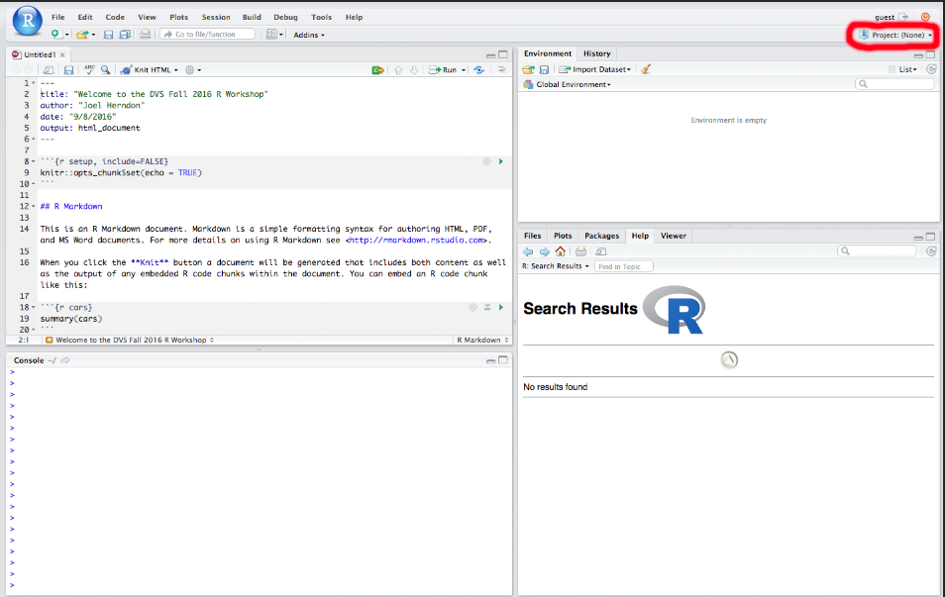

Slide 9
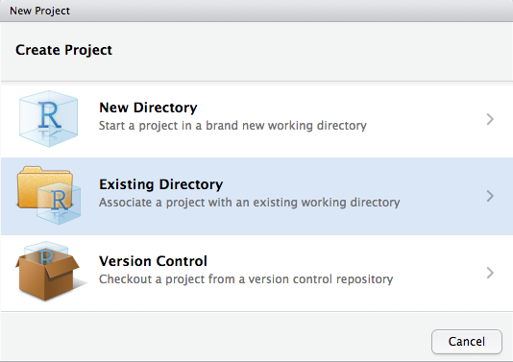

Slide 10
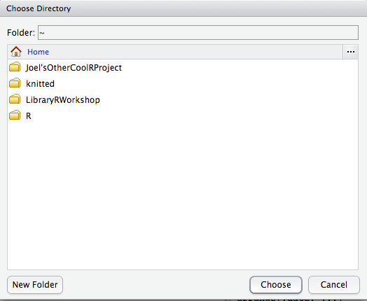

Slide 11
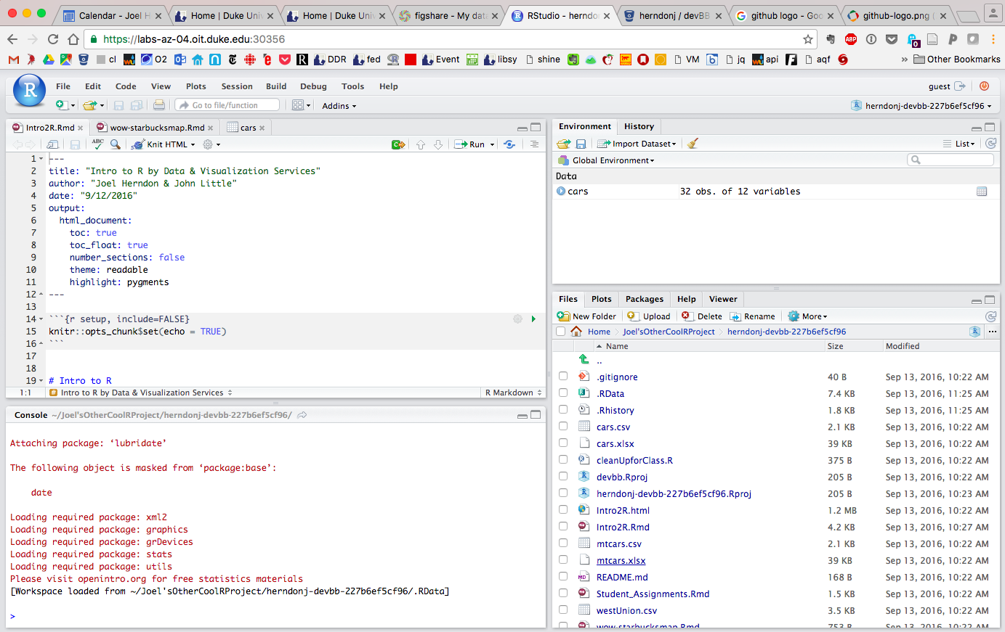

Slide 12
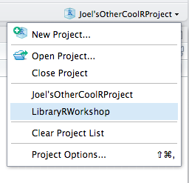
Notes:
Class should download zip file at this point.

Slide 13
(A few) Benefits of R
1. Open source/free
2. Extensible
3. Integrated tools for reproducible research
4. Integrated tools for data sharing/publication
5. A full suite of data structures
6. Ability to chain commands to build complex workflows

Slide 14
What can you do?
Notes:
Cool R Examples!

Slide 15
R Basics
(and a few data types)
Notes:
For today, we are really focused on:
1.) Typing commands at the command line
2.) Working with dataframes (explain that)
3.) BUT- we’d be remiss if we didn’t talk a little about the data type used to build dataframes.

Slide 16
(Selected) Data STructures
(and a few data types)

Slide 17
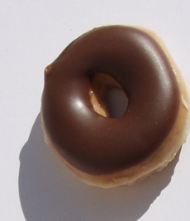
vectors
A container for data of the same type
Can hold numbers, text, logical values
type <- “plain”
calories <- 200
topping <- “chocolate”
delicious <- TRUE
available <- NA
type
[1] “plain”
Notes:
Mode() for type
Scalars as one item vectors

Slide 18
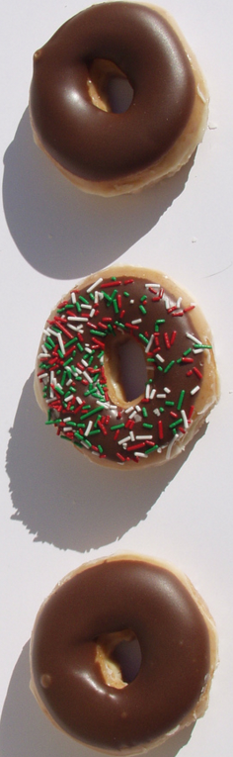
vectors
A container for data of the same type
Indexed starting at one
type <-c(”plain”,“chocolate”)
calories <- c(200,225)
topping<- c(“sprinkles”,”sugar”)
boxSpot<- c(“First”,”Second”)
type[2]
[1] “chocolate”
Notes:
R will coerce values to the same type (most likely strings) if you try to mix data types.

Slide 19

missing data
Missing data in R is represented by NA
(Note: you may still have implicit missing data)
NA represents “Not available”
Comparison operators will not detect NA
Use missing value functions like “is.na()”
type <- “plain”
calories <- 200
topping <- “chocolate”
delicious <- TRUE
available <- NA
is.na(available)
[1] TRUE
Notes:
Note- NA is used for both character and numeric in R

Slide 20

data frames
Source: bit.ly/1QRSmlf

Slide 21
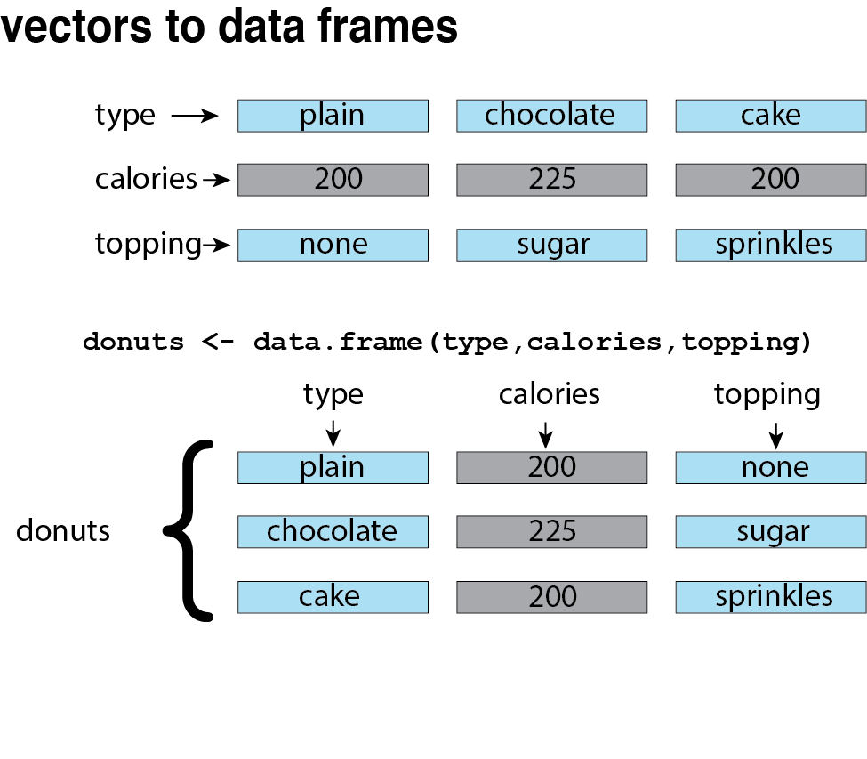

Slide 22


Slide 23
HELP!

Slide 24




Getting Help Online
Google – add“r” or “rstats” to your search
Stack Overflow – add “[r]” to your search
rseek.org (Google, but focused on R)
Quick R – statmethods.net

Slide 25
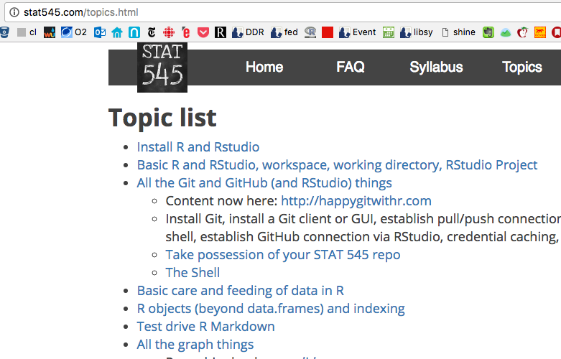
Stat545 – Jenny Bryan’s UBC Course on Stats in R
Notes:
And a personal favorite....

Slide 26
Getting Help At the Command Line
help(functionName) or ?functionName
??topic #search the help system
appropos(“topic”)
vignette(“topic”)

Slide 27




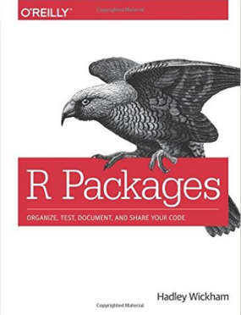



Extending R
...And many more....

Slide 28
Today’s goals
Notes:
1.) Loading Data
2.) Data Management in five commands
3.) Basic graphs
4.) Want to do more? Let’s talk.

